Slide 1
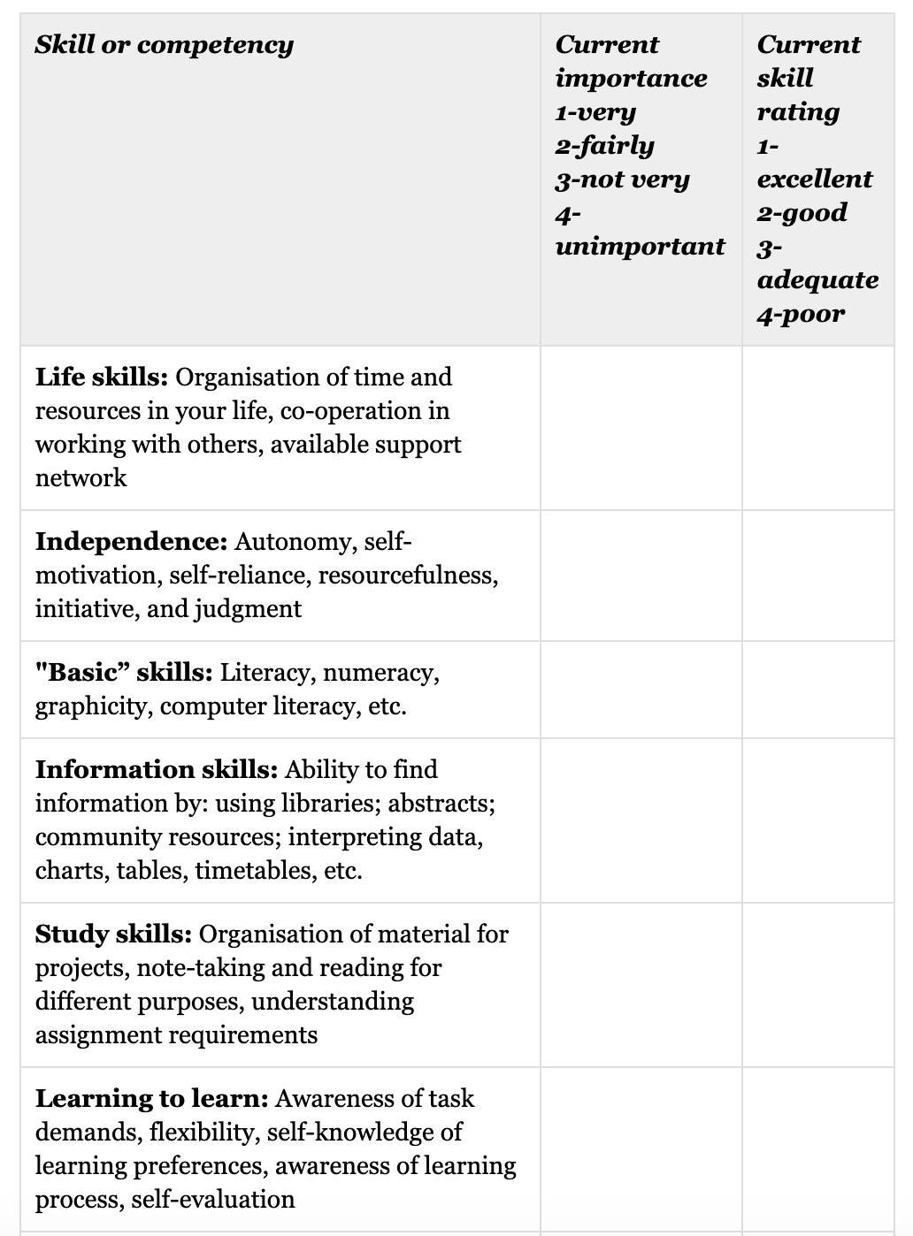
Independent Studies: Readiness to Learn
Many skills and attitudes towards learning are required for success in an independent study environment. The following learning skills assessment tool will help you evaluate your readiness to learn independently. Consider completing this evaluation on your own in addition to being rated by someone else who knows you well. While self-reflection is important, it is always useful to receive feedback from someone else who knows you and how you work. Also, review the scores with your advising faculty member for input. Under the current importance column, a score of 1, for example, indicates that the item is currently very important to you. Under the current skill rating column, however, a score of 1 indicates that you feel you have an excellent set of skills pertaining to the item.
Helpful hint: Return to this review at mid and end points in the unit as a tool for evaluating your skill development.
1
4
1
2
1
2
1
3
1
3
1
3

Slide 2
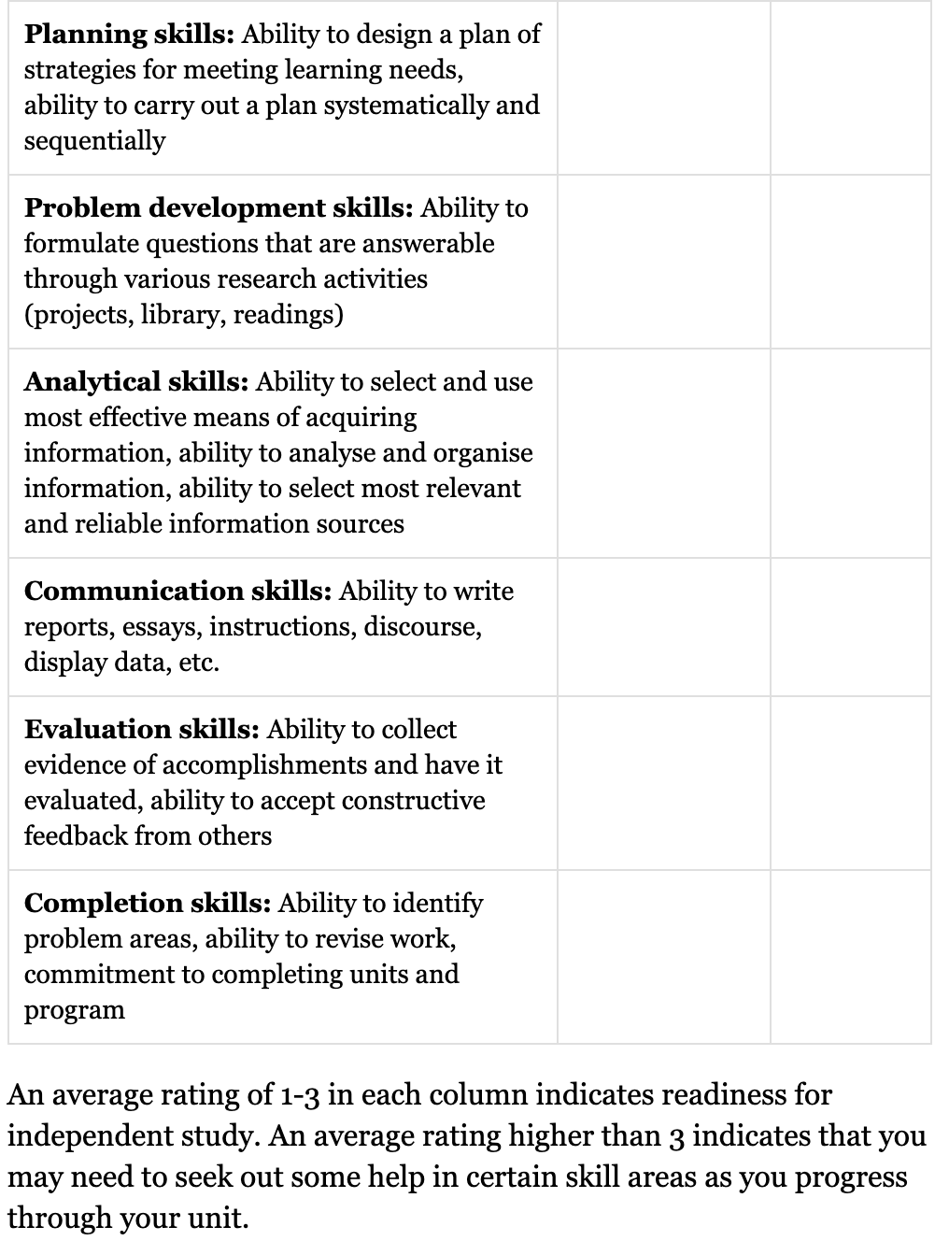
1
2
2
2
1
1
2
1
2
3
1
3
Average Current skill rating: 2.4

